Slide 1
Social Behavior

Slide 2
Social Behavior
Social psychology is the scientific study of how individuals behave, think, and feel in social situations
Social context includes
People
Activities and interactions amongst them
Setting
Expectations and social norms to be followed in that setting

Slide 3
Social Standards of Behavior
Social norms: a group’s expectations regarding what is appropriate and acceptable for it’s members’ attitudes and behaviors
Social roles are patterns of behavior expected of persons in various social positions

Slide 4
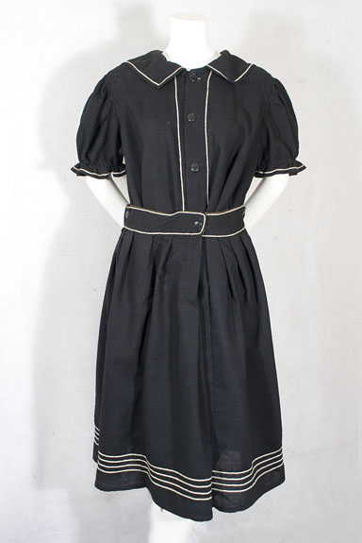

Slide 5
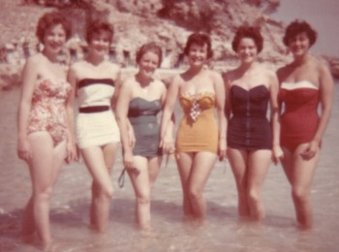

Slide 7
Conformity
The tendency for people to adopt the behaviors, attitudes and opinions of other members of a group
Script
Chameleon Effect
Asch Effect

Slide 8
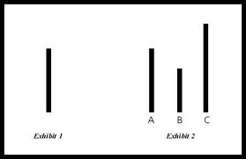
Asch Experiment

Slide 9
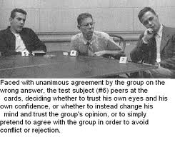
Asch Experiment

Slide 10
Groupthink
Poor judgments and bad decisions made by members of groups that are overly influenced by perceived group consensus or the leader’s point of view
Dominant Leader
High group cohesiveness (loyalty)
Lack of norms requiring legitimate procedures for evidence collection/situation evaluation
Homogeneity of members’ social background and ideology
High stress and insurmountable trust in leader

Slide 11
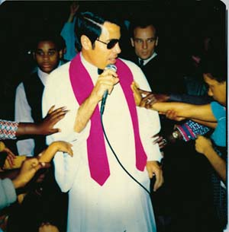

Slide 12
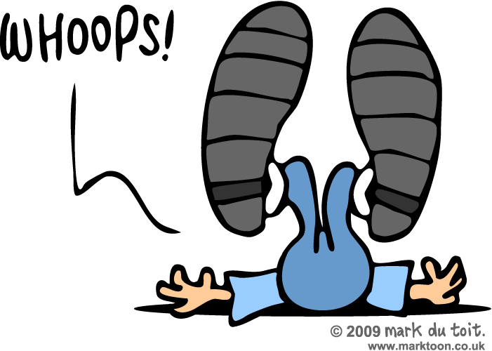
Bystander Intervention Problem
Diffusion of Responsibility:
Dilution or weakening of each group member’s obligation to help
The thinking amongst most people is that someone else will help

Slide 13
What Influences Our Judgment of Others?
Reward Theory: We like best those who gives us maximum rewards at the minimum cost
Principle of Proximity: people make connections with others with whom they have the most contact
Similarity Principle: the idea that people are attracted to those who are most similar to themselves in most areas

Slide 14
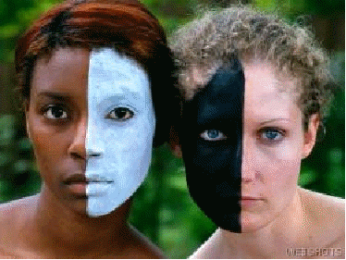
Prejudice & Discrimination
Prejudice: a negative emotional attitude held against members of a particular group of people
Discrimination: treating members of various social groups differently in circumstances where their rights or treatment should be identical

Slide 15
Cognitive Dissonance
A clash between self-image, thoughts, beliefs, attitudes or perceptions and one’s behavior

